Slide 1

PVA Africa Network Meeting
October 26, 2021

Slide 2
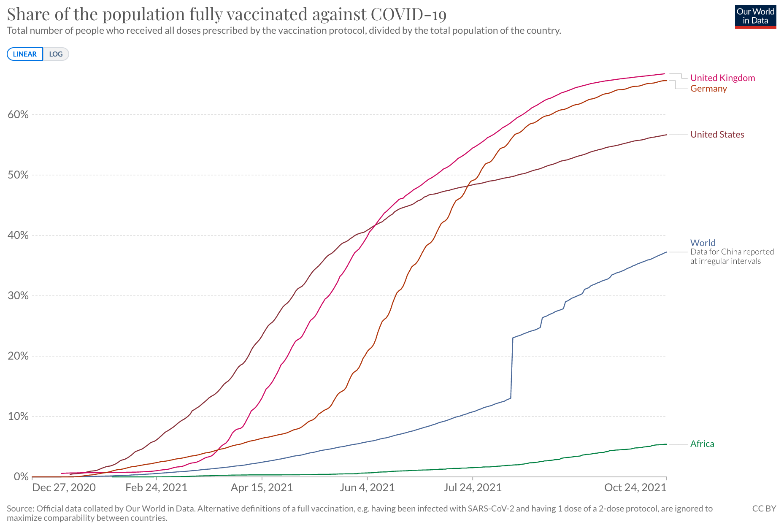

Vaccine Rollout Snapshot
Notes:
UK: 66.7%
Germany: 65.6%
US: 56.7%
World: 37.1%
Africa: 5.4%
USA has fully vaccinated 3x more people than Africa despite having a population 4x smaller

Slide 3
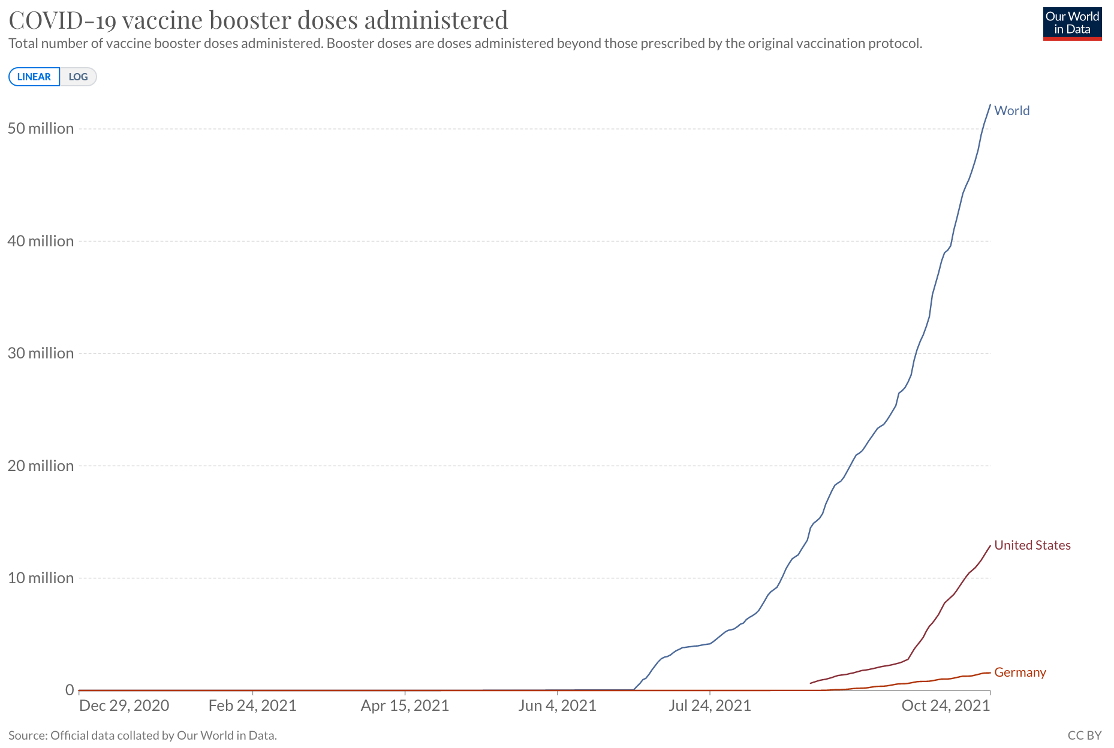
Booster Vaccine Rollout Snapshot
Notes:
The US has delivered more booster shots than 30 African countries have fully vaccinated people

Slide 4
Today’s agenda
Review of September reports and any follow-up items.
October achievements and challenges (PVA Global and from the attendees)
Upcoming events (November & December) with a focus on brainstorming re the Africa Week of Action.
PVA Africa Manifesto.

Slide 5
What is the PVA??
The People’s Vaccine Alliance is a coalition over 75 organizations and networks, with the support of over 170 former Heads of State, Nobel Laureates, faith leaders, health experts, economists and other notable figures fighting to end vaccine apartheid.
We are united under a common aim of campaigning for a ‘people’s vaccine’ for COVID-19. This would be based on shared knowledge, and freely available to everyone, everywhere - a global common good.

Slide 6
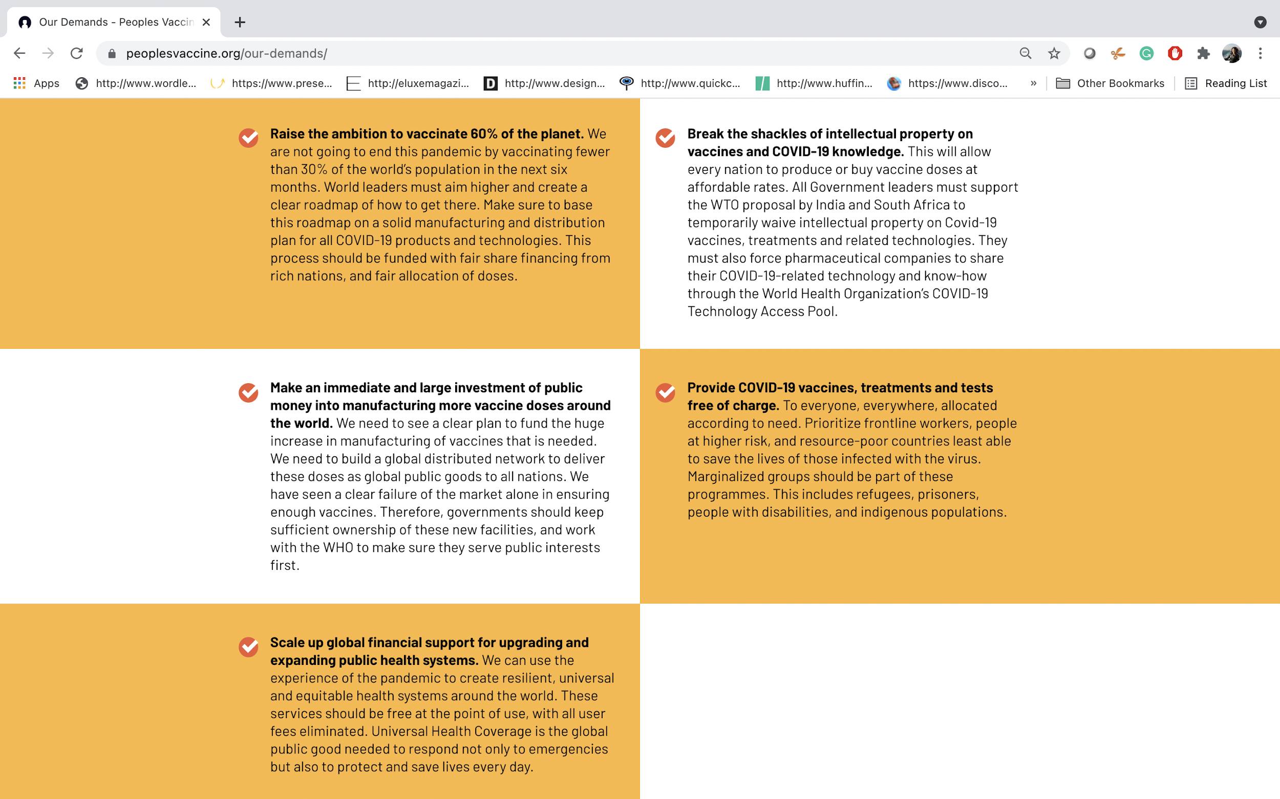
OUR
DEMANDS
Notes:
As you read this, governments and corporations are failing to make what should be the easiest possible choice: whether to save millions of lives by providing equal access to the COVID-19 vaccines.
A year ago, the barrier to beating this cruel disease was science. Today it is inequality. We have the ability to vaccinate the world and to end this pandemic. But instead, rich countries are hoarding vaccines and protecting the profits of their pharmaceutical corporations instead of saving lives.
Agree and implement a global roadmap to herd immunity, with at least 60% of people across all countries offered a vaccine by the end of 2021 and a vaccine for all who need one by end of 2022.
Suspending relevant intellectual property rules and ensuring the mandatory pooling of all COVID-19 related knowledge, data and technologies (WTO WAIVER & C-TAP)
Invest public funding now in a rapid and massive increase in vaccine manufacturing as well as research and development (R&D) capacity to build a global distributed network
COVID-19 vaccines, treatments and tests are provided free of charge to everyone, everywhere, and allocated according to need.
Scale up sustainable investment in public health systems

Slide 7
STRATEGIC PRIORITIES
    Pushing Germany – and rest of blockers mainly Europe – to back waiver and pursue tech transfer (waiver and tech transfer are highly interlinked)
    Amplify voice of Global South people and countries, on cost of inaction and readiness to manufacture (amplifying data, building capacity of spokespeople, sharing stories)
    Increase heat on big pharmaceutical corporations – with continued goal of one corporation into C-TAP
  Also: Amplify the work of others; identify key opportunities
Notes:
COVID-19 Technology Access Pool (C-TAP), launched by WHO in partnership with the Government of Costa Rica and 40 Member State co-sponsors with the Solidarity Call to Action, has called to action the global community to voluntarily share knowledge, intellectual property and data necessary for COVID-19. C-TAP is intended to provide a means to accelerate the development of products needed to fight COVID-19 as well as to accelerate the scale-up of manufacturing and the removal of barriers to access in order to make products available globally. Sharing information, knowledge, data and other resources is a powerful way to accelerate product development and avoid unnecessary duplication of efforts arising from the absence of such sharing.

Slide 8
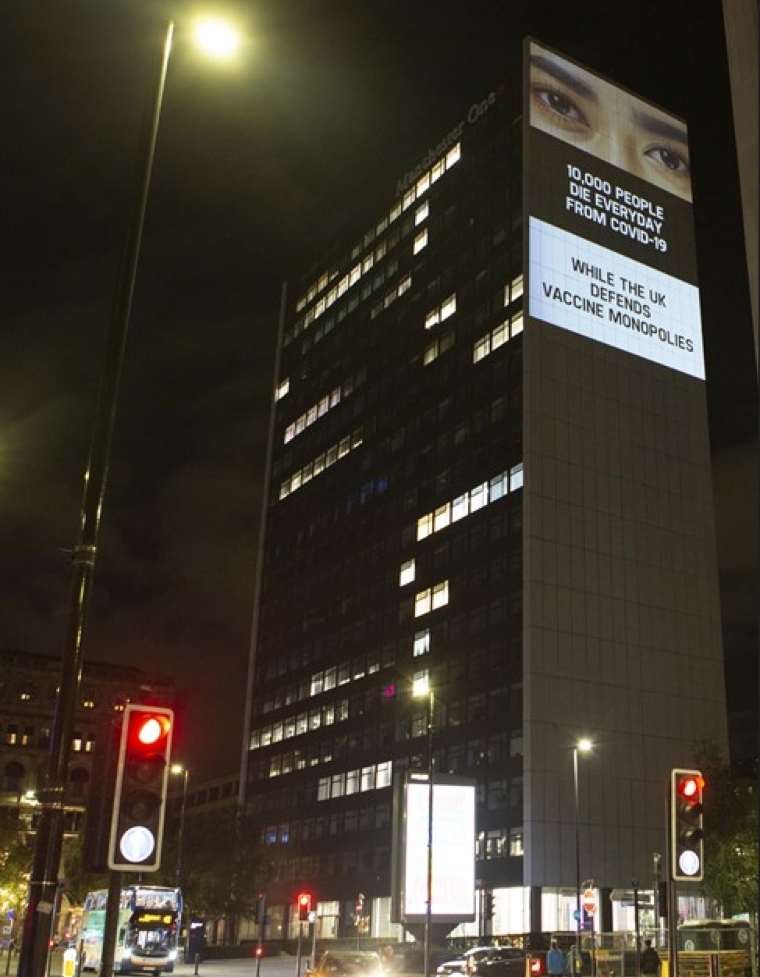
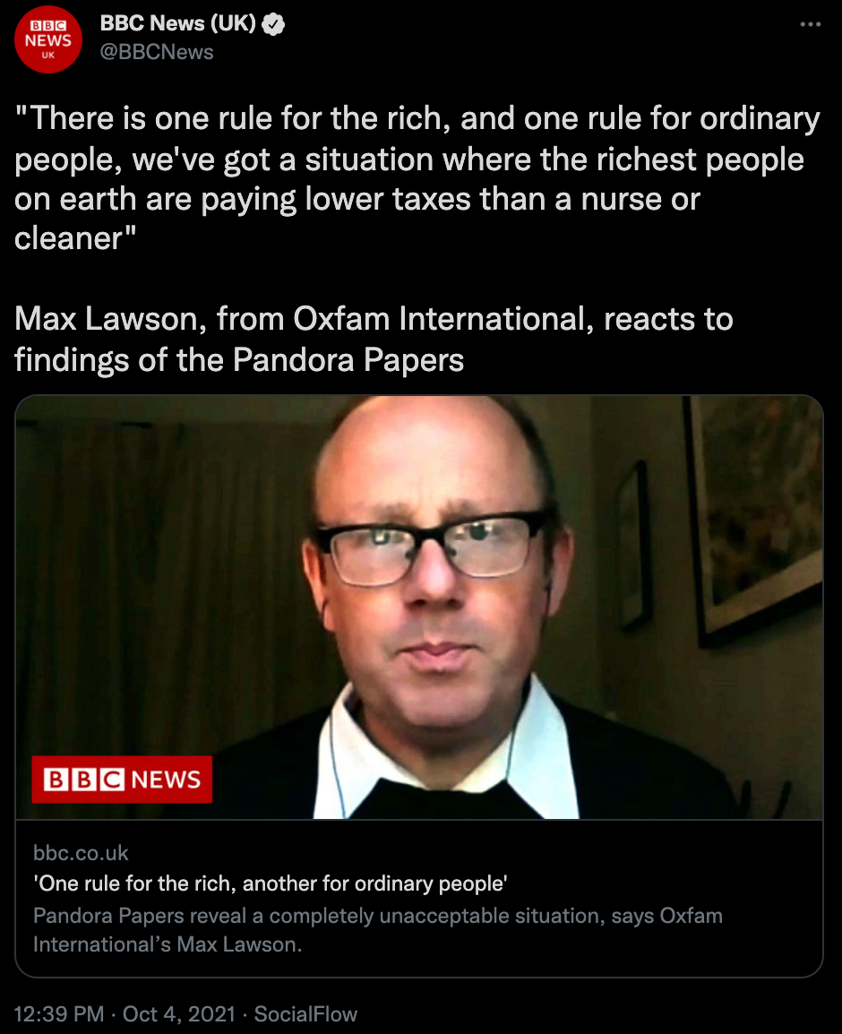

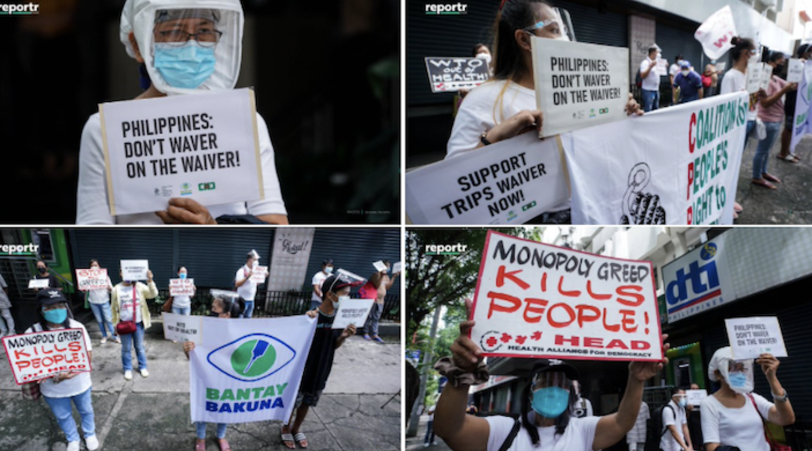

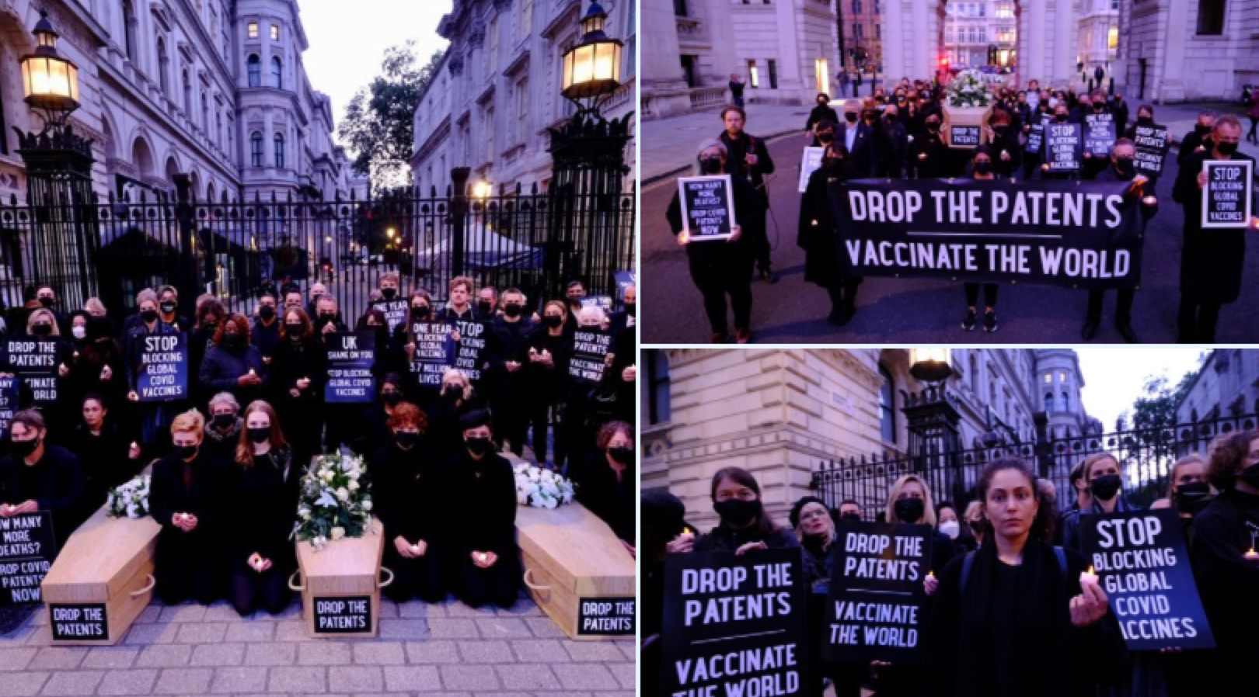
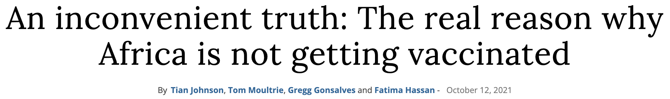
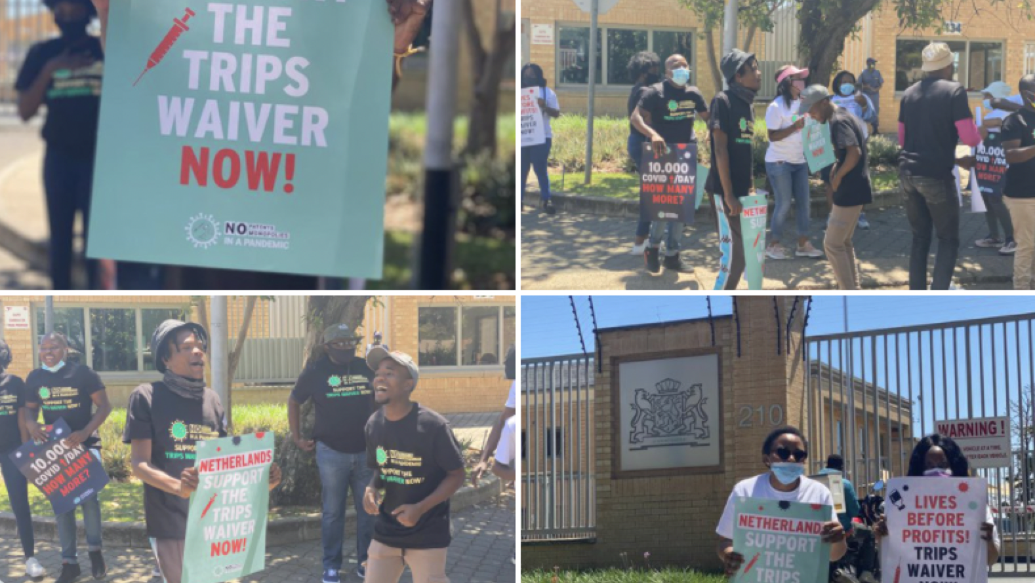
A FEW PVA OCTOBER HIGHLIGHTS
Manchester
Philippines
London and Edinburgh
South Africa
Notes:
1) Projection – arranged by StopAIDS, Global Justice Now and Oxfam GB - ran for about two hours shaming Boris Johnson and the Tories for their inaction on vaccine monopolies. Overlooking a busy street with lots of foot traffic, people on the street stop to see what was going on.
2) PVA Co-Chair Max Lawson has been on BBC lambasting the rich and governments about all money stolen from better-financed health systems!
3) Great Panel Discussion on Access Barriers to Covid-19 Therapeutics & Diagnostics: A Case for TRIPS Waiver happened today led by People's Health Movement and Third World Network. Speakers from Drugs for Neglected Diseases initiative, MSF Access Campaign and Yale National Clinician Scholars Program led the discussions, chaired by Jyotsna Signh of the PHM
4) Amazing mobilization across the world ahead of the WTO TRIPS council.
5) Activists from Section27 and MSF in South Africa protested outside Netherland, Belgium & USA embassies.
6) In the Philippines, Members of the Coalition for People's Right to Health protested in front of the DTI office yesterday to urge the government to support calls to waive patents on COVID19 vaccines.
7) Two brilliant pieces in Bhekisisa by PVA members about the real reason Africa is not getting vaccinated as fast as other continents and why some people think the pandemic is “not that bad” in Africa: An inconvenient truth: The real reason why Africa is not getting vaccinated (https://bhekisisa.org/opinion/2021-10-12-an-inconvenient-truth-the-real-reason-why-africa-is-not-getting-vaccinated/) and A confusing COVID caseload: Why Africa’s missing numbers show a different side to the pandemic (https://bhekisisa.org/opinion/2021-10-22-a-confusing-covid-caseload-why-africas-missing-numbers-show-a-different-side-to-the-pandemic/)

Slide 9


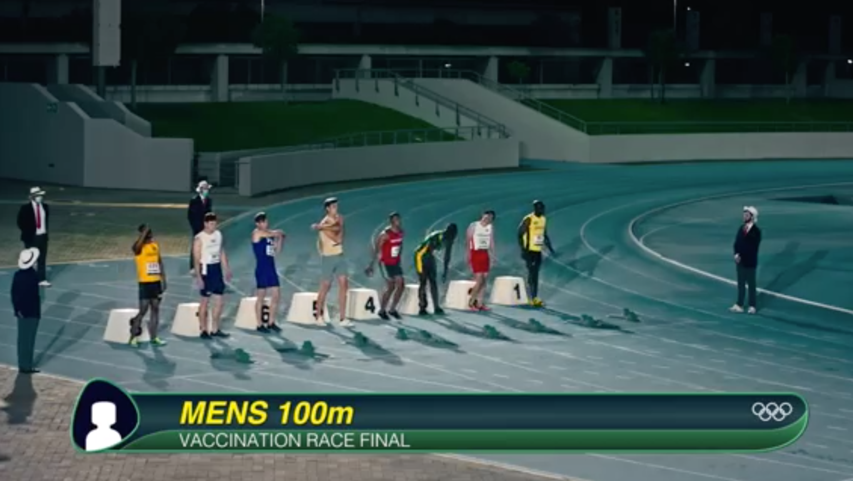
A FEW PVA OCTOBER HIGHLIGHTS
Notes:
The PVA released A Dose of Reality report on how rich countries and pharmaceutical corporations are breaking their vaccine promises. The report found that of the 1.8 billion COVID vaccine donations promised by rich nations only 14 % have been delivered to date, while western pharmaceutical companies have delivered only 12 % of the doses they allocated to COVAX: https://app.box.com/s/kygk0i850bo18l33vk5p3qwyq9umk527
The PVA developed the Race Against COVID film. Available in multiple languages: https://app.box.com/s/k7az9h18usl9ott3uvim31p4qr6il137
PVA member (Public Citizen) published a report titled Pfizer’s Power outlining how Pfizer, the world’s second-largest pharmaceutical corporation, silences and intimidates governments in vaccine negotiations. It shows how Pfizer has throttled supply, shifted risk, and maximized profits during the worst public health crisis in a century: https://www.citizen.org/article/pfizers-power/
PLEASE FOLLOW THE PVA ON TWITTER FOR REGULAR UPDATES: @peoplesvaccine

Slide 10
Key Upcoming Dates
    G20 in Rome 30-31 October
      Check the PVA’s G20 website page for updates on what the Alliance is doing/planning for the G20: https://peoplesvaccine.org/g20/
    COP26 in Glasgow 31 October - 12 Nov
    One year anniversary of Ensemble (J&J) trial launch in SA: 6 Nov
    World AIDS Day: 1 Dec
    Kusi Ideas Festival: first week of December
    One year anniversary of first COVID-19 vaccine (Pfizer) being administered in the UK: 8 Dec
Notes:
Any dates to add from Africa?

Slide 11


