Slide 1

PVA Africa Network Meeting
September 28, 2021

Slide 2
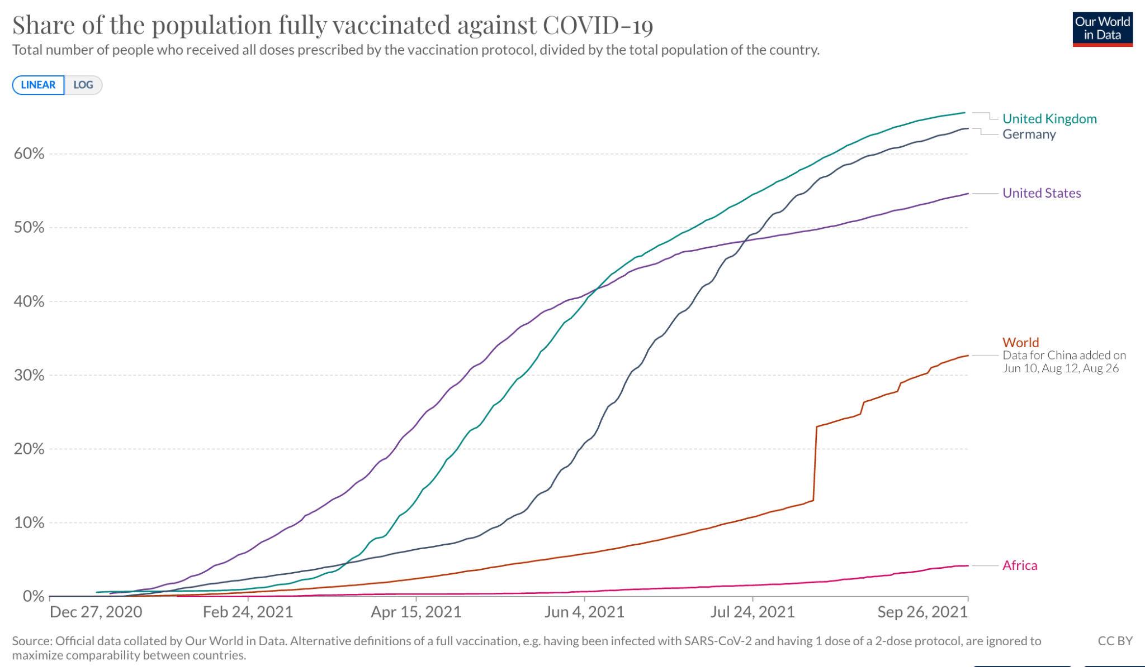

Vaccine Rollout Snapshot
Notes:
UK: 66%
US: 55%
World: 33%
Africa: 4.2%

Slide 3
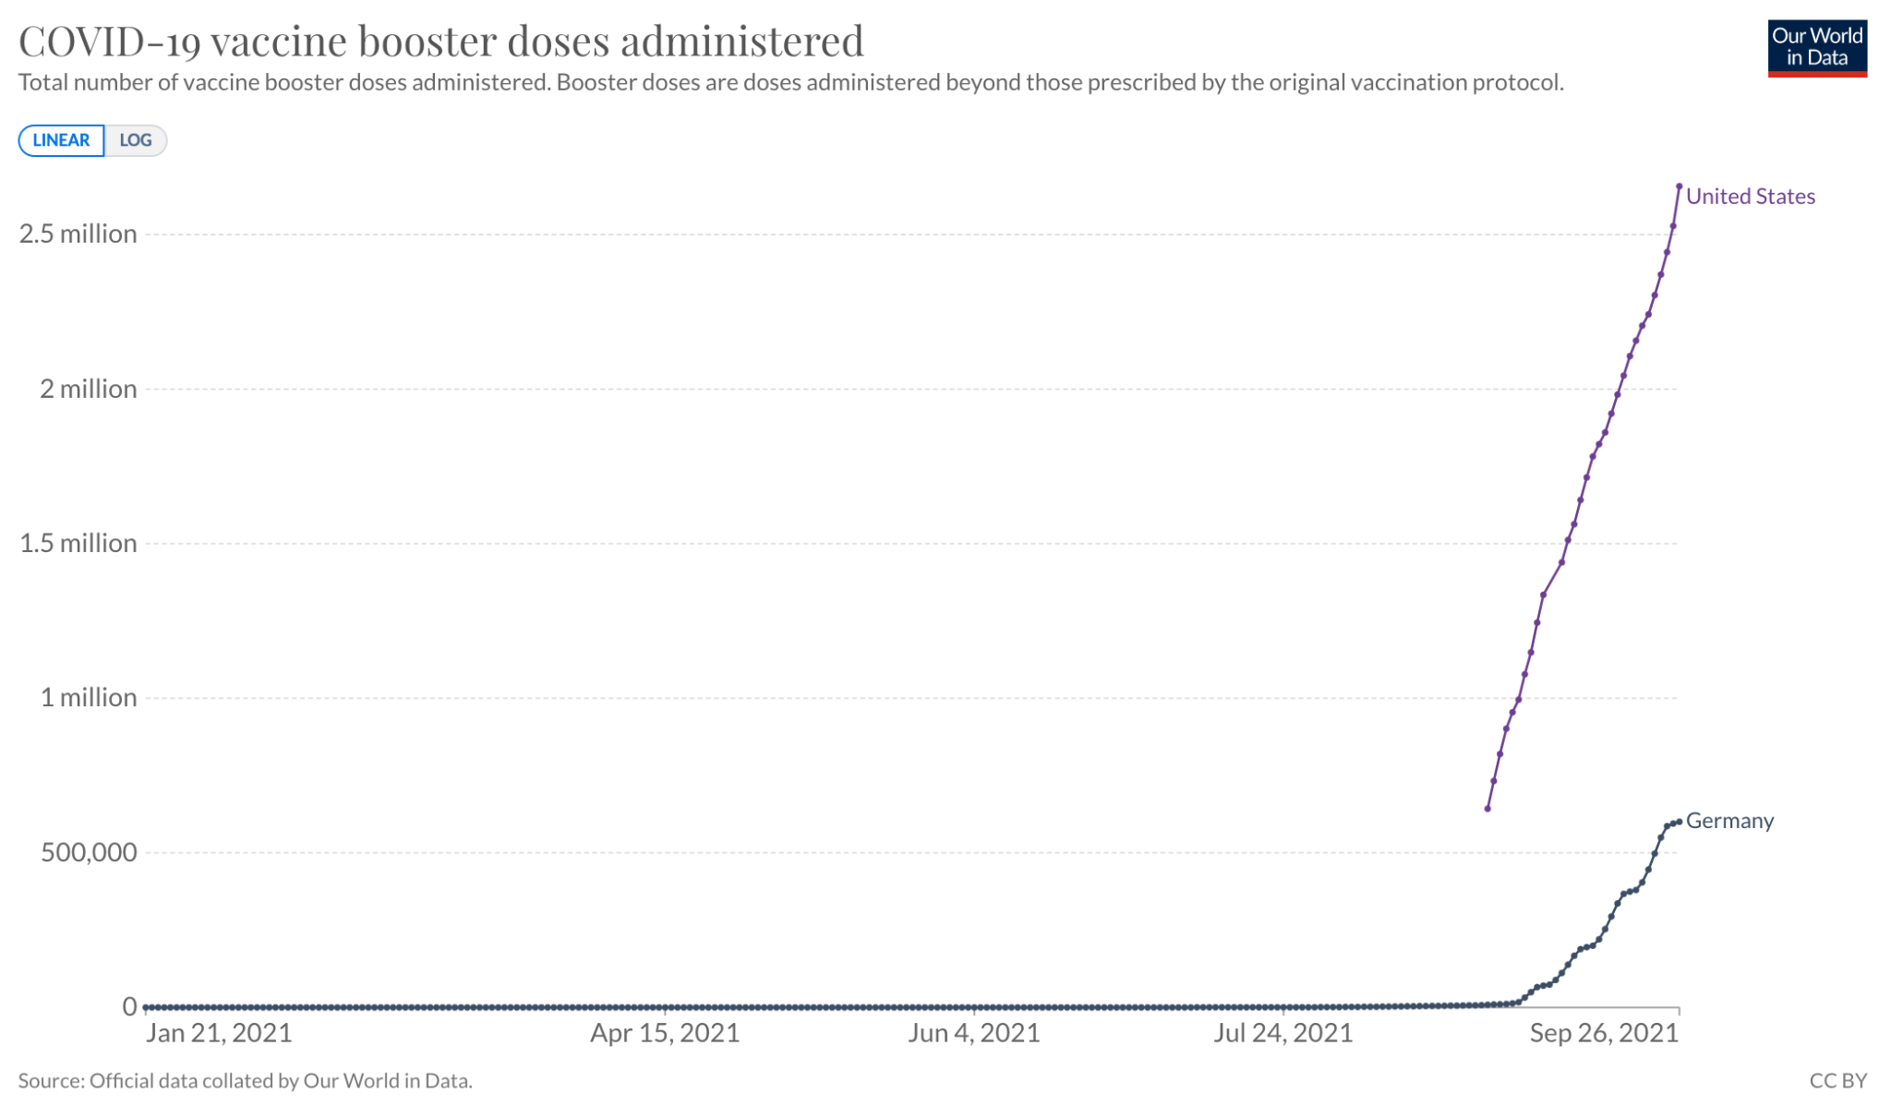
Booster Vaccine Rollout Snapshot
Notes:
Roughly 800,000 people in Ethiopia are fully vaxxed vs. 2.5 million in US who have received booster shot

Slide 4
Today’s agenda
  Brief intro re PVA for new attendees (if necessary).
  Review of last month’s meeting report & action items.
  Review of “Africa COVID-19 brief” and comments for September
  Week of Action: Key Achievements
  Updates from across the continent: burning issues, recent activities, and points that we – as a collective - need to address
  Upcoming key dates, events, and advocacy opportunities.
  Discussion with Dr. Mohga Kamal-Yanni (PVA Senior Health Policy Advisor) on holding African leaders more accountable on issues of vaccine access & equity.
  Any other business.

Slide 5
What is the PVA??
The People’s Vaccine Alliance is a coalition over 75 organizations and networks, with the support of over 170 former Heads of State, Nobel Laureates, faith leaders, health experts, economists and other notable figures fighting to end vaccine apartheid.
We are united under a common aim of campaigning for a ‘people’s vaccine’ for COVID-19. This would be based on shared knowledge, and freely available to everyone, everywhere - a global common good.

Slide 6
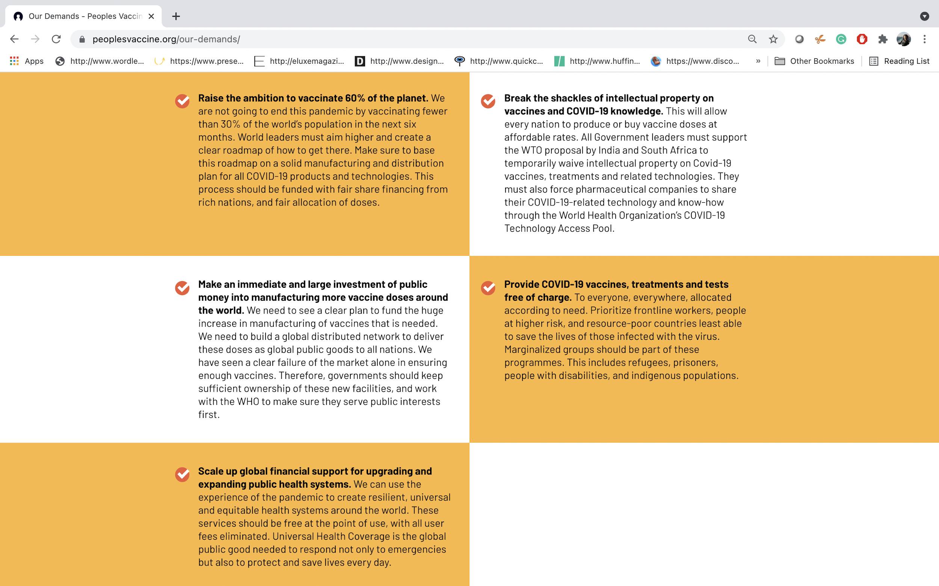
OUR
DEMANDS
Notes:
As you read this, governments and corporations are failing to make what should be the easiest possible choice: whether to save millions of lives by providing equal access to the COVID-19 vaccines.
A year ago, the barrier to beating this cruel disease was science. Today it is inequality. We have the ability to vaccinate the world and to end this pandemic. But instead, rich countries are hoarding vaccines and protecting the profits of their pharmaceutical corporations instead of saving lives.
Agree and implement a global roadmap to herd immunity, with at least 60% of people across all countries offered a vaccine by the end of 2021 and a vaccine for all who need one by end of 2022.
Suspending relevant intellectual property rules and ensuring the mandatory pooling of all COVID-19 related knowledge, data and technologies (WTO WAIVER & C-TAP)
Invest public funding now in a rapid and massive increase in vaccine manufacturing as well as research and development (R&D) capacity to build a global distributed network
COVID-19 vaccines, treatments and tests are provided free of charge to everyone, everywhere, and allocated according to need.
Scale up sustainable investment in public health systems

Slide 7
Steering Group
(made up of the chairs of the four groups and the overall PV chair)
Campaigns and media group
Policy and advocacy group
Influentials group (including faith leaders)
Notes:
Temporary groups
G7/G20
German group
EU group
Storytelling Group
Advisory groups
Pharmaceutical Advisory Group
Sister campaigns
EU- no profit on pandemic
UK- missing medicines
US – US alliance

Slide 8
PVA STRATEGIC PRIORITIES
    Pushing Germany – and rest of blockers mainly Europe – to back waiver and pursue tech transfer (waiver and tech transfer are highly interlinked)
    Amplify voice of Global South people and countries, on cost of inaction and readiness to manufacture (amplifying data, building capacity of spokespeople, sharing stories)
    Increase heat on big pharmaceutical corporations – with continued goal of one corporation into CTAP
  Also: Amplify the work of others; identify key opportunities
Notes:
COVID-19 Technology Access Pool (C-TAP), launched by WHO in partnership with the Government of Costa Rica and 40 Member State co-sponsors with the Solidarity Call to Action, has called to action the global community to voluntarily share knowledge, intellectual property and data necessary for COVID-19. C-TAP is intended to provide a means to accelerate the development of products needed to fight COVID-19 as well as to accelerate the scale-up of manufacturing and the removal of barriers to access in order to make products available globally. Sharing information, knowledge, data and other resources is a powerful way to accelerate product development and avoid unnecessary duplication of efforts arising from the absence of such sharing.

Slide 9

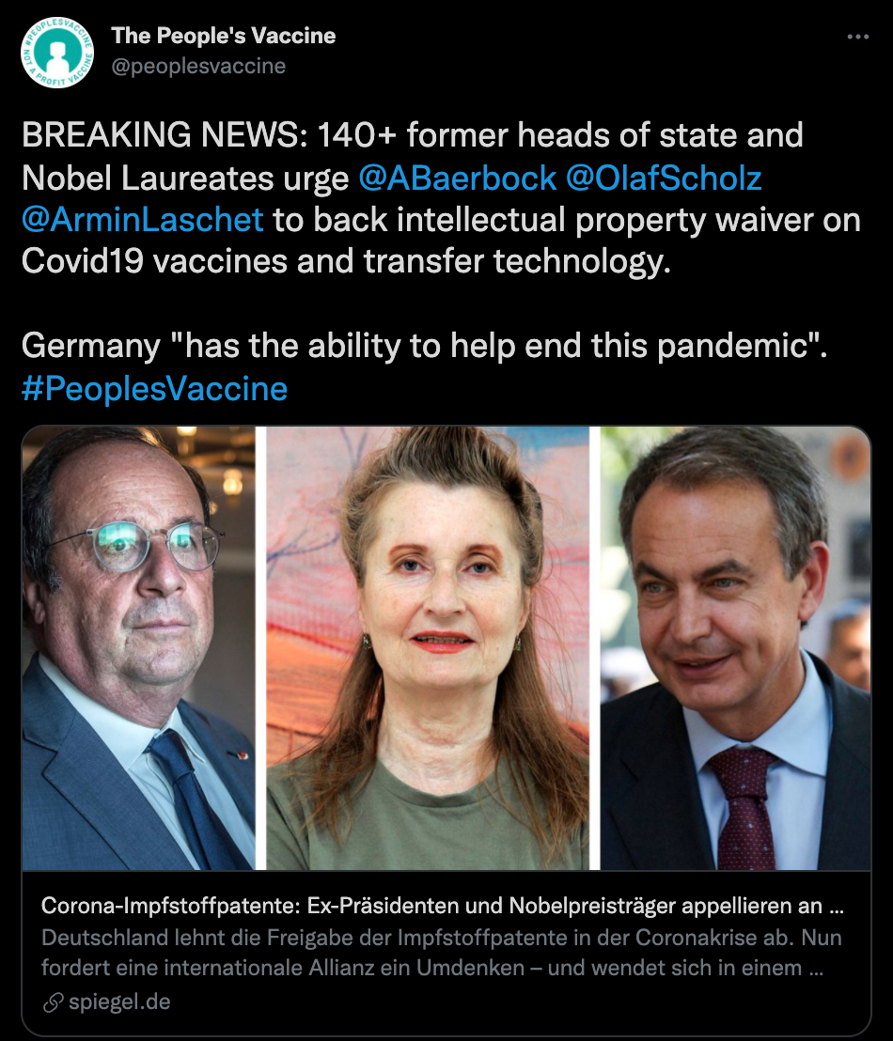

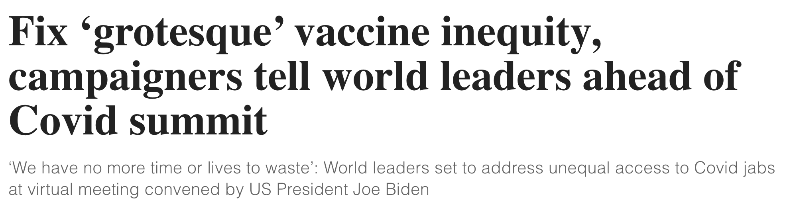
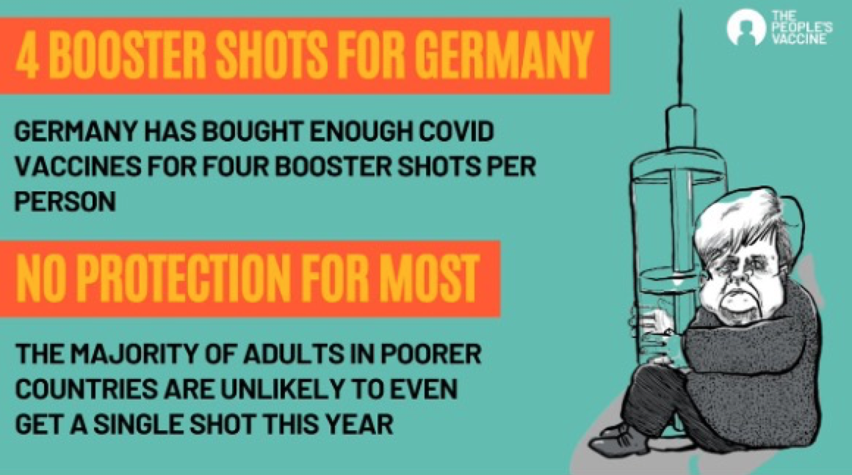
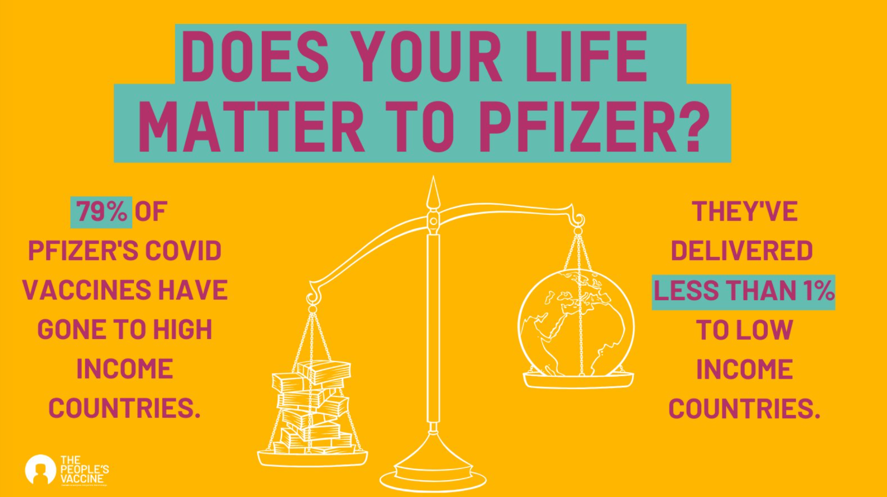

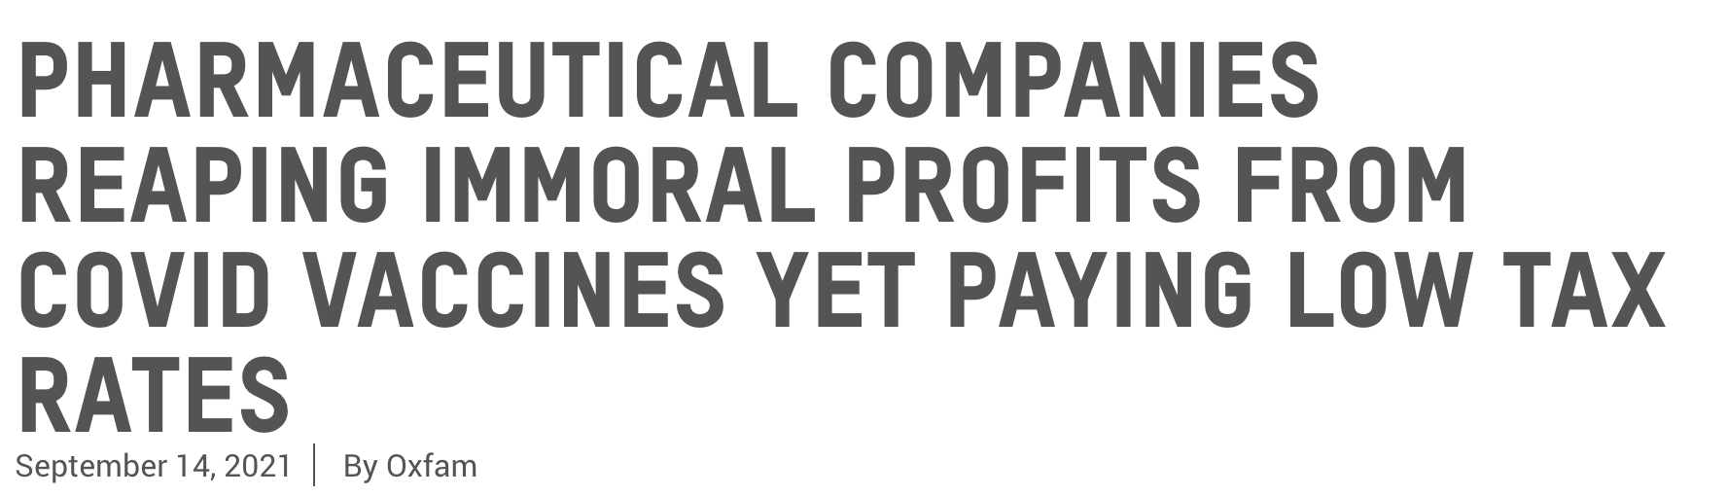
PVA HIGHLIGHTS FROM SEPTEMBER
Notes:
Fix ‘grotesque’ vaccine inequity, campaigners tell world leaders ahead of Covid summit
https://www.independent.co.uk/news/health/covid-vaccine-summit-biden-latest-b1924245.html
Independent (22 September, 2021)
Empty promises will not save the world from COVID, campaigners warn ahead of Biden global vaccine summit
https://www.oxfamamerica.org/press/press-releases/empty-promises-will-not-save-the-world-from-covid-campaigners-warn-ahead-of-biden-global-vaccine-summit/
PVA Press Release (22 September, 2021)
Pharmaceutical companies reaping immoral profits from COVID vaccines yet paying low tax rates
https://www.oxfamamerica.org/press/press-releases/pharmaceutical-companies-reaping-immoral-profits-from-covid-vaccines-yet-paying-low-tax-rates/
PVA Press Release (14 September, 2021)

Slide 10
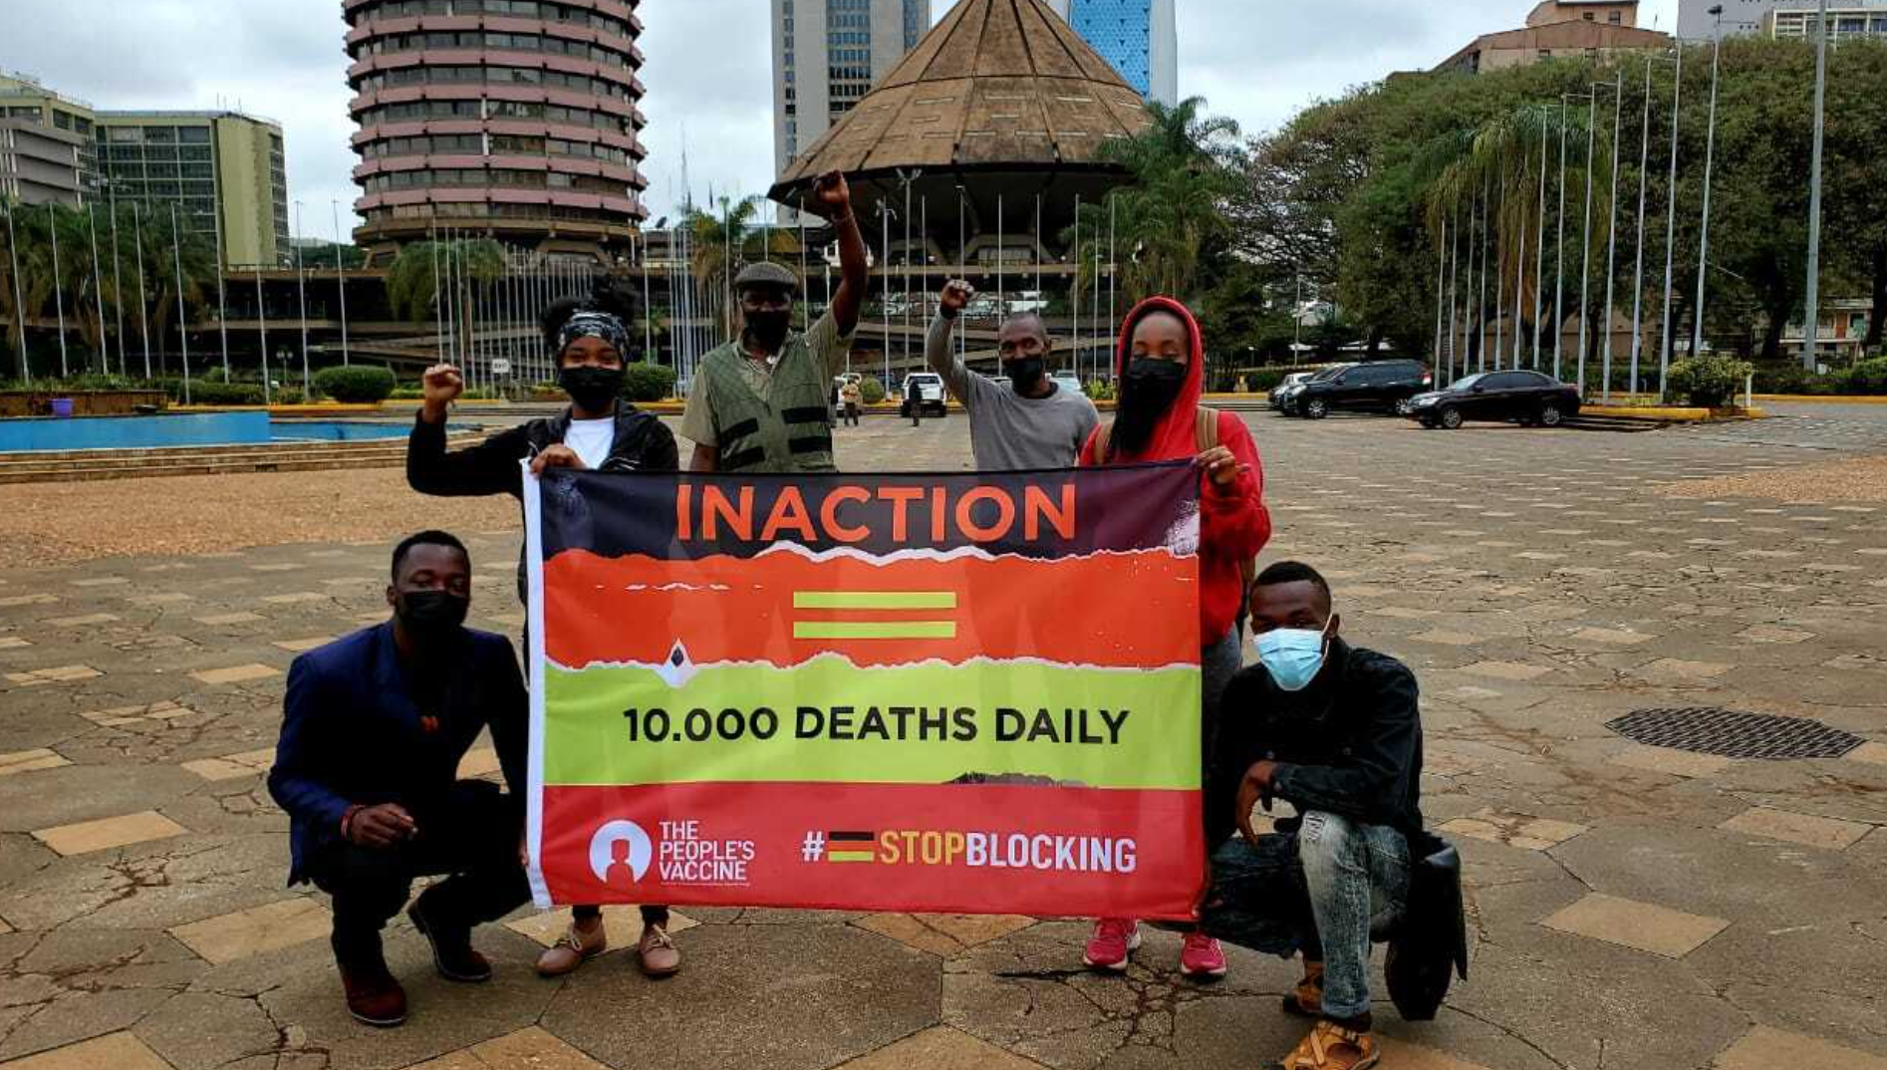
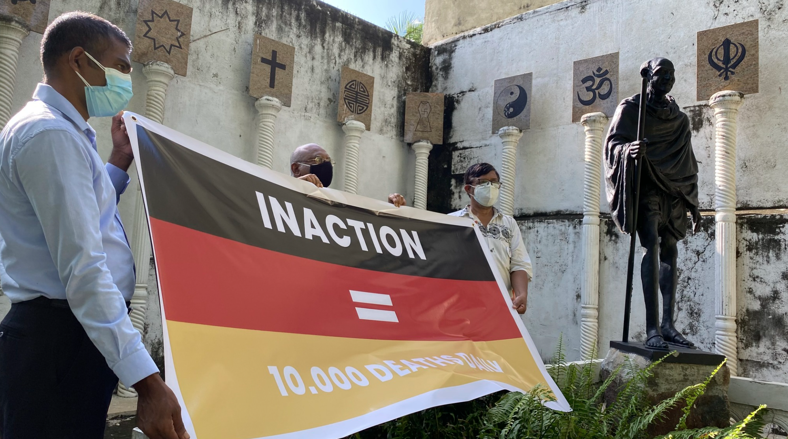
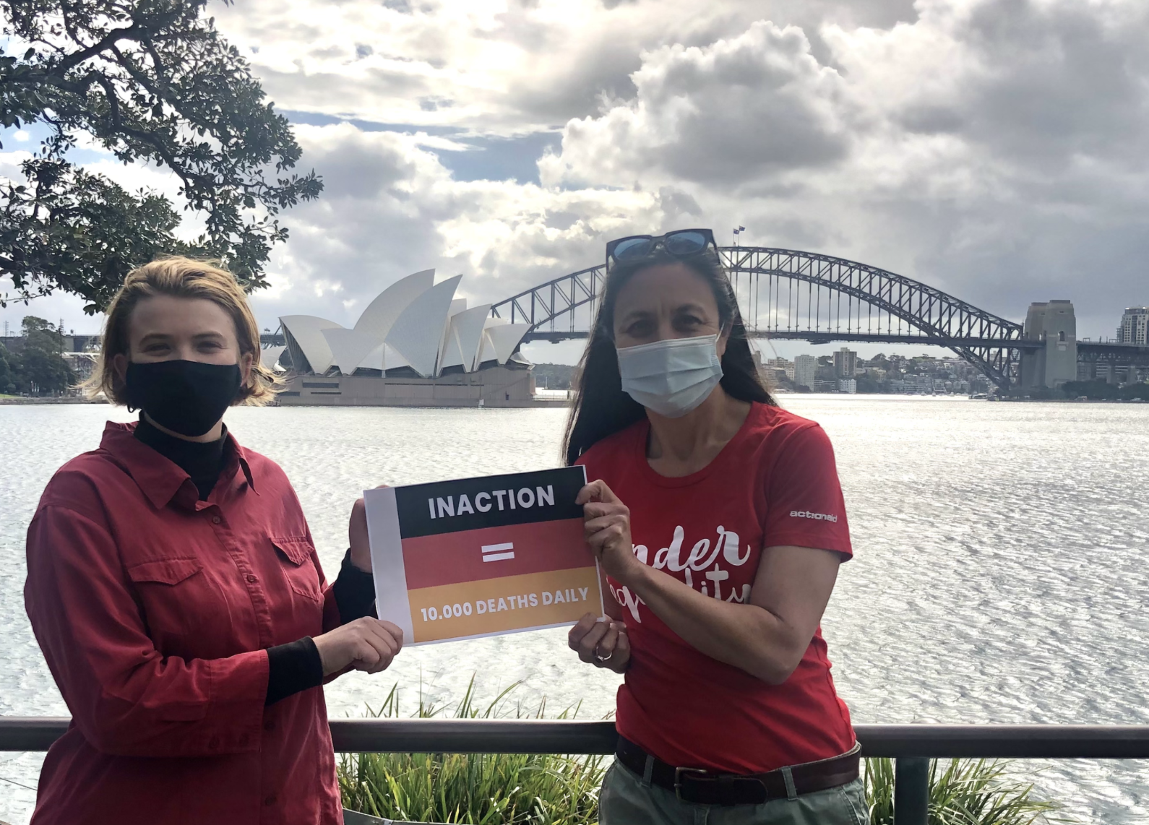
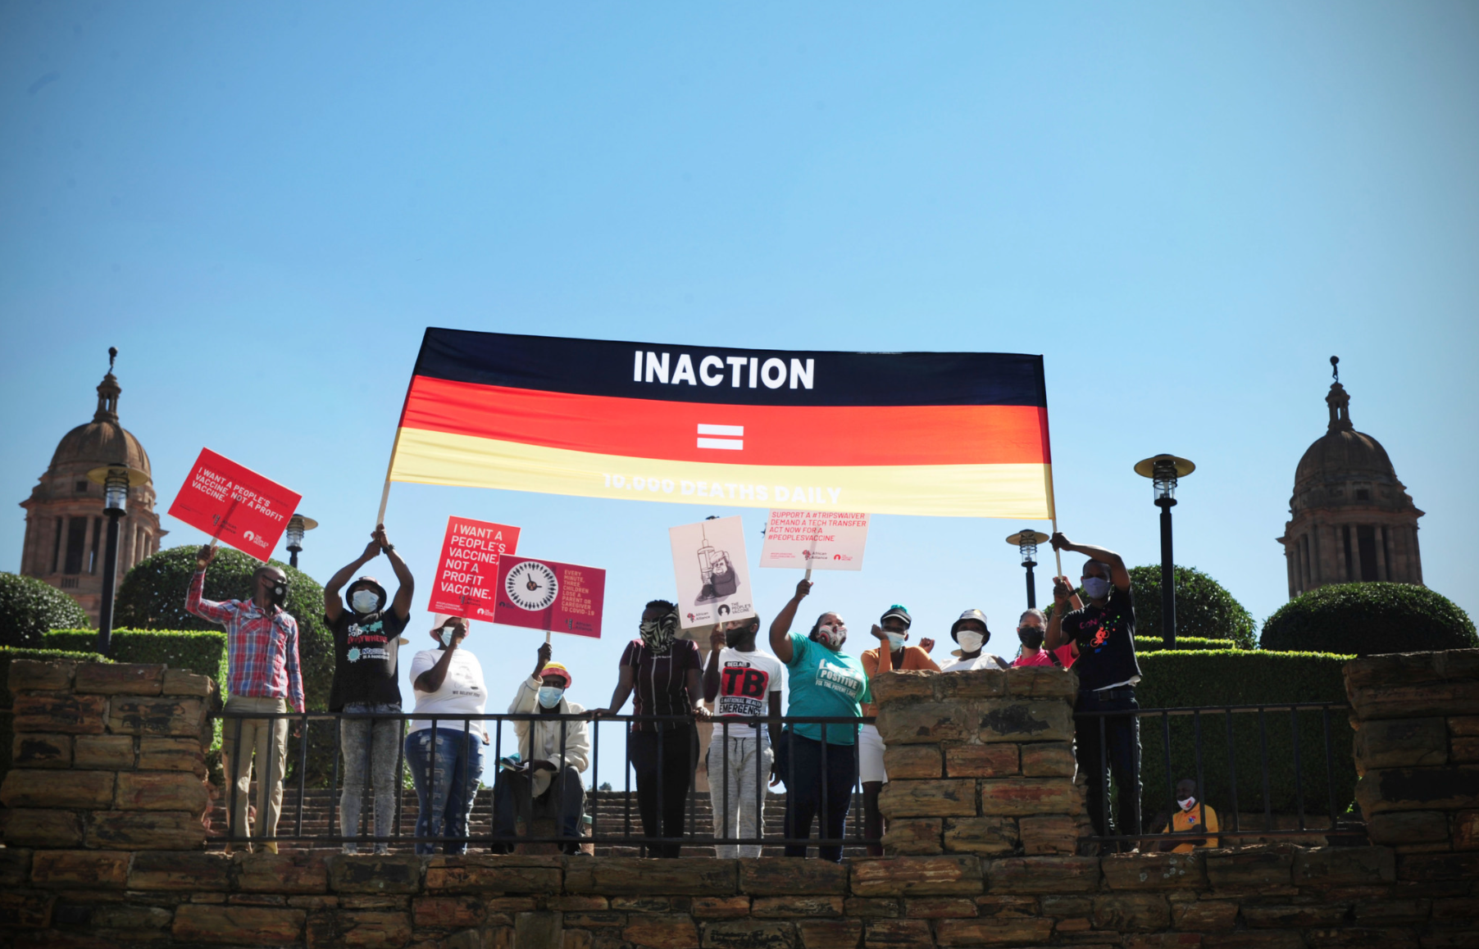
DAY OF ACTION TARGETING GERMANY
Kenya
Sri Lanka
Australia
South Africa

Slide 11
Key Upcoming Dates
    One year anniversary since submission of TRIPS Waiver Application 2 October
    Nobel Prize Nomination Announcement 4 October
    One year anniversary of Ensemble (J&J) trial launch in Sa: 6 Nov
    World AIDS Day: 1 Dec
    One year anniversary of first COVID-19 vaccine being administered: 8 Dec
    SEE PVA GLOBAL CALENDAR FOR MORE
Notes:
Any dates to add from Africa?

Slide 12


